Slide 1

Craft of Statistical Analysis
Steve Simon for
Notes:
Analyzing Repeated Measures Data Workshop: Module 5 The Linear Mixed Model
Copyright 2011 The Analysis Factor http://TheAnalysisFactor.com
1

Slide 2
Abstract
Craft of Statistical Analysis
Survival analysis is a collection of statistical tools that were developed to assist with mortality studies. A common feature of these survival analysis tools is the ability to include censored data, data from people who drop out during the study. These tools allow you to use the information from these censored observations to help estimate survival probabilities up to and including the day that they dropped out. Although survival models were originally developed for mortality events, you can adapt them to many other outcomes, such as customer churn, restaurant closings, defoliation of plants, and metal fatigue. The outcomes do not necessarily have to be “bad” events. Survival analysis is also useful for successful completion of training for guide dogs and time to pregnancy in couples with fertility problems.
In this talk you will see a variety of Kaplan-Meier curves, the fundamental graphical display for survival data and learn how to interpret these curves. You’ll also see the underlying calculations of a Kaplan-Meier curve and an advanced application of competing risks analysis using a Political Science example of duration of leadership in the world’s countries.

Slide 3
Fruit fly data (round 1)
Where does this data come from?
The following data represents survival time for a group of fruit flies and is a subset of a larger data set found at the Data and Story Library (DASL). The data set has been slightly modified to simplify some of these explanations.
There are 25 flies in the sample, with the first fly dying on day 37 and the last fly dying on day 96. If you wanted to estimate the survival probability for this data, you would draw a curve that decreases by 4% (1/25) every time a fly dies.
.

Slide 4
Fruit fly data (round 1)
At each date, the survival probability drops by 1/25.
37 96% 40 92% 43 88% 44 84% 45 80% 47 76% 49 72% 54 68% 56 64% 58 60% 59 56% 60 52% 61 48% 62 44% 68 40% 70 36% 71 32% 72 28% 73 24% 75 20% 77 16% 79 12% 89 8% 94 4% 96 0%.
.

Slide 5
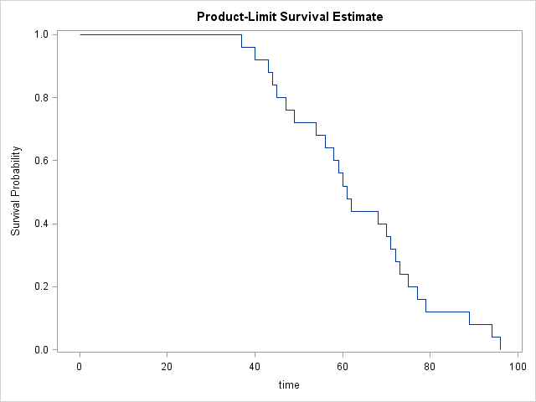
Fruit fly data (round 1)
A graphical depiction of the survival probability

Slide 6
Fruit fly data (round 2)
Let’s alter the experiment
Now let's alter the experiment. Suppose that totally by accident, a technician leaves the screen cover open on day 70 and all the flies escape. You're probably worried that the whole experiment has been ruined. But don't be so pessimistic. You still have complete information on survival of the fruit flies up to their 70th day of life. Here's how you would present the data and estimate the survival probabilities.

Slide 7
Fruit fly data (round 2)
You can still estimate some survival probabilities
37 96% 40 92% 43 88% 44 84% 45 80% 47 76% 49 72% 54 68% 56 64% 58 60% 59 56% 60 52% 61 48% 62 44% 68 40% 70+ ? 70+ ? 70+ ? 70+ ? 70+ ? 70+ ? 70+ ? 70+ ? 70+ ? 70+ ?
.

Slide 8
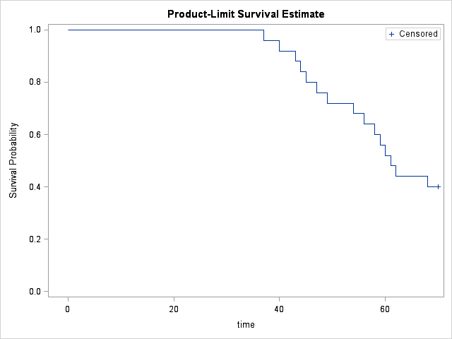
Fruit fly data (round 2)
Here is a graph of the survival probabilities

Slide 9
Fruit fly data (round 2)
What you can still estimate
We clearly have enough data to make several important statements about survival probability. For example, the median survival time is 61 days because roughly half of the flies had died before this day.
By the way, you might be tempted to ignore the ten flies who escaped. But that would seriously bias your results. The median survival time, for example, of the 15 flies who did not escape, for example, is only 54 days which is much smaller than the actual median.

Slide 10
Fruit fly data (round 3)
Another change to the data
Let's look at a third experiment, where the screen cover is left open and all but four of the remaining flies escape. It turns out that those four remaining flies who didn't bug out will allow us to still get reasonable estimates of survival probabilities beyond 70 days. Here is the data and the survival probabilities.

Slide 11
Fruit fly data (round 3)
Here are the estimated survival probabilities
37 96% 40 92% 43 88% 44 84% 45 80% 47 76% 49 72% 54 68% 56 64% 58 60% 59 56% 60 52% 61 48% 62 44% 68 40% 70+ ? 71 30% 70+ ? 70+ ? 75 20% 70+ ? 70+ ? 89 10% 70+ ? 96 0%

Slide 12
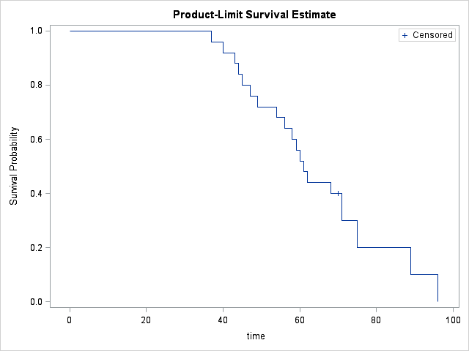
Fruit fly data (round 3)
Here is a graph of the survival probabilities

Slide 13
An Introduction to Kaplan-Meier Curves
Fruit fly data (round 3)
What you do with the six escaped flies is to allocate their survival probabilities equally among the four flies who didn't bug out. This places a great responsibility among each of those four remaining flies since each one is now responsible for 10% of the remaining survival probability, their original 4% plus 6% more which represents a fourth of the 24% survival probability that was lost with the six escaping flies.

Slide 14
Fruit fly data (round 3)
Informative censoring
If the censoring mechanism were somehow related to survival prognosis, then you would have the possibility of serious bias in your estimates. Suppose for example, that only the toughest of flies (those with the most days left in their short lives) would have been able to escape. The flies destined to kick the bucket on days 70, 71, 72, and 73, were already on their deathbeds and unable to fly at all, much less make a difficult escape. Then these censored values would not be randomly interspersed among the remaining survival times, but would constitute some of the larger values. But since these larger values would remain unobserved, you would underestimate survival probabilities beyond the 70th day.

Slide 15
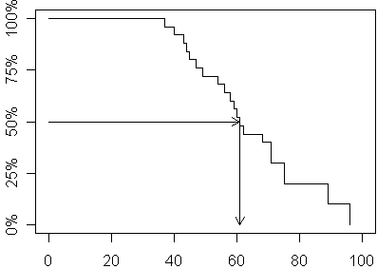
Fruit fly data (round 3)
Interpretation: 50th percentile = 61

Slide 16
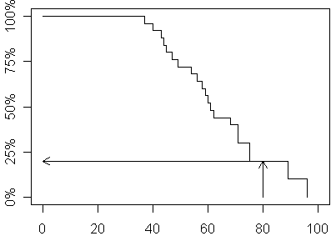
Fruit fly data (round 3)
Interpretation: 80 week survival probability = 20%

Slide 17


Slide 18
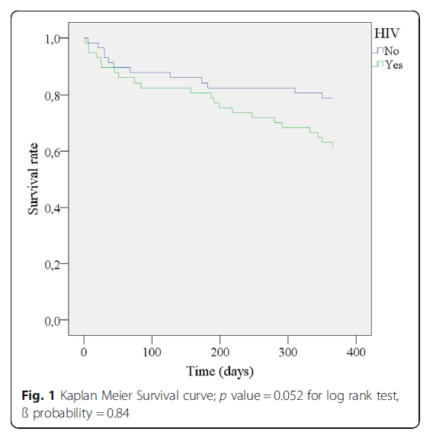

Slide 19


Slide 20
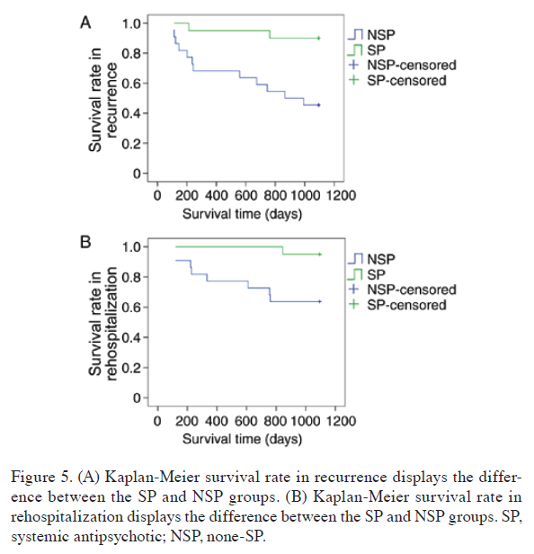

Slide 21


Slide 22
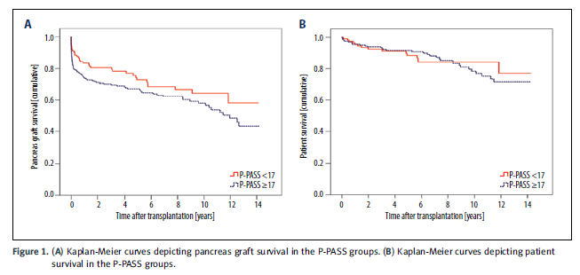

Slide 23


Slide 24
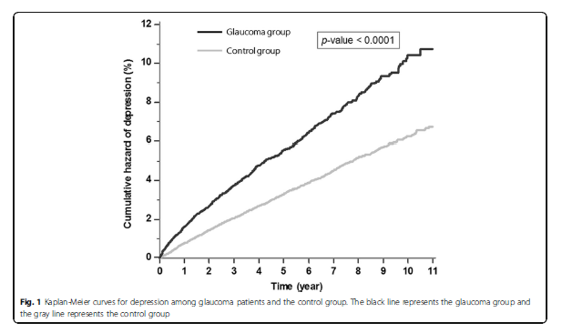

Slide 25


Slide 26
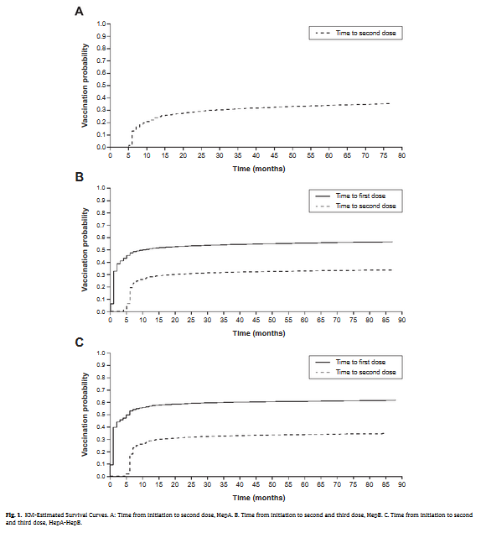

Slide 27


Slide 28
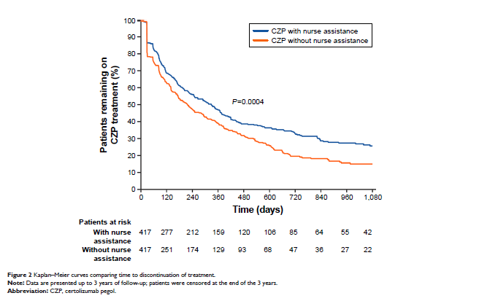

Slide 29


Slide 30
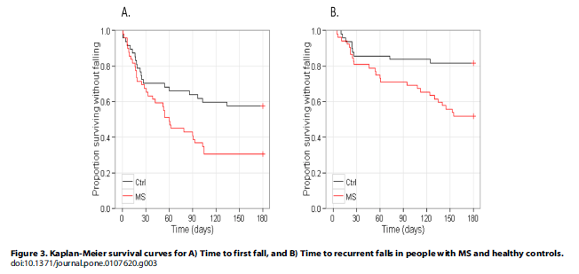

Slide 31


Slide 32
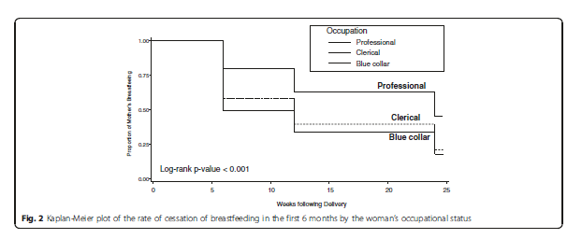

Slide 33


Slide 34
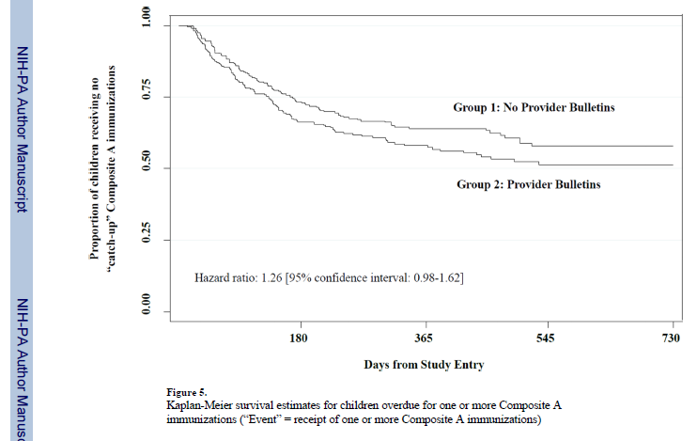

Slide 35
The leader data set
Overview
This data set tracks leaders of countries of the world and how long they stay in power. Leaders can be removed by constitutional means, by natural death, or by nonconstitutional means (military coup or assassination, for example). This data set is restricted to 1960 through 1987, and does not include North America.

Slide 36
The leader data set
Variables
years Min. 1st Qu. Median Mean 3rd Qu. Max.
0.000 1.000 3.000 5.114 7.000 27.000
lost still in power constitutional exit
111 146
natural death nonconstitutional exit
27 154

Slide 37
The leader data set
Variables
manner constitutional ascent
280
nonconstitutional ascent
158
start Min. 1st Qu. Median Mean 3rd Qu. Max.
1960 1965 1973 1973 1979 1987
military no yes
294 144

Slide 38
The leader data set
Variables
age Min. 1st Qu. Median Mean 3rd Qu. Max.
17.00 41.00 50.00 49.39 56.75 81.00
conflict low conflict medium/high conflict
166 272
loginc Min. 1st Qu. Median Mean 3rd Qu. Max.
4.094 5.075 5.858 5.916 6.565 9.546

Slide 39
The leader data set
Variables
growth Min. 1st Qu. Median Mean 3rd Qu. Max.
-7.00 0.50 1.50 1.63 3.40 8.50
pop Min. 1st Qu. Median Mean 3rd Qu. Max.
0.008 2.600 7.000 35.780 24.000 1088.000
Land Min. 1st Qu. Median Mean 3rd Qu. Max.
0.02 49.00 238.00 739.97 912.00 9596.00

Slide 40
The leader data set
Variables
literacy Min. 1st Qu. Median Mean 3rd Qu. Max.
5 32 65 59.41 85 99
region middle east africa
60 132
asia latin america
91 155

Slide 41
The leader data set
Check for sufficient number of events in each group
manner 0 1
constitutional ascent 70 210
nonconstitutional ascent 41 117
military 0 1
no 70 224
yes 41 103

Slide 42
The leader data set
Check for sufficient number of events in each group
conflict 0 1
low conflict 42 124
medium/high conflict 69 203
region 0 1
middle east 18 42
africa 42 90
asia 26 65
latin america 25 130

Slide 43
The leader data set
Create cut-points for continuous variables
start_c 60s 70s 80s
176 159 103
age_c 0-39 40-59 60+
89 265 84
loginc_c $0-200 $200-500 $500+
130 149 159

Slide 44
The leader data set
Create cut-points for continuous variables
growth_c neg 0-3.9% 4%+
85 275 78
pop_c under 1m 1-10m 10m+
70 189 179

Slide 45
The leader data set
Create cut-points for continuous variables
land_c under 100 sq km 98
100-1,000 sq km 142
1,000-10,000 sq km 198
literacy_c 0-50% 50-75% 75-100%
163 103 172

Slide 46
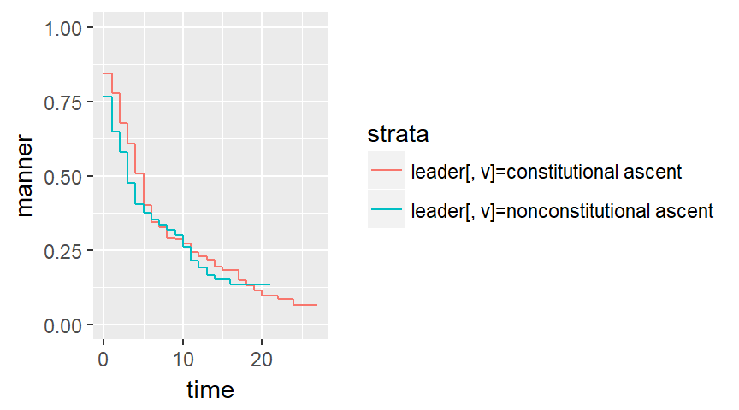
The leader data set, Kaplan-Meier curves

Slide 47
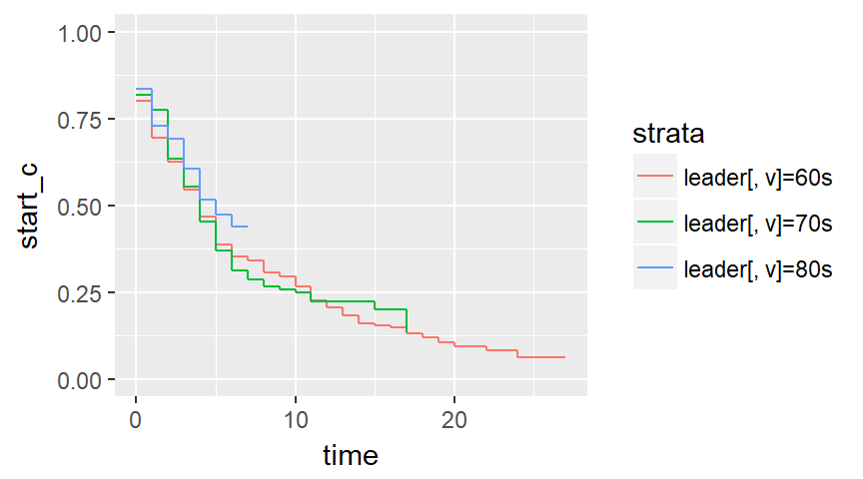
The leader data set, Kaplan-Meier curves

Slide 48
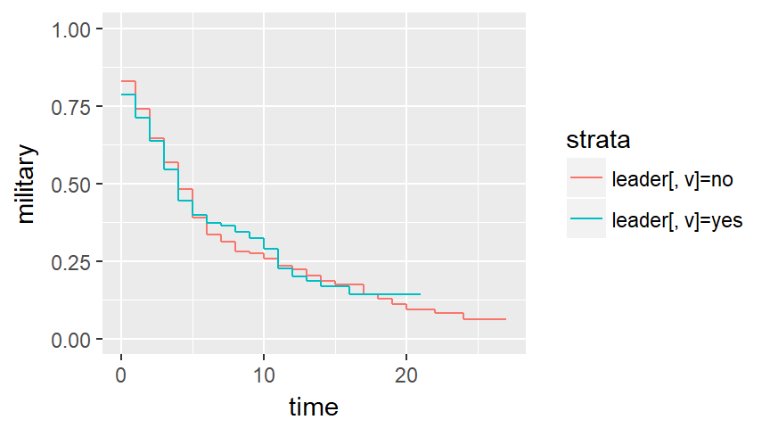
The leader data set, Kaplan-Meier curves

Slide 49
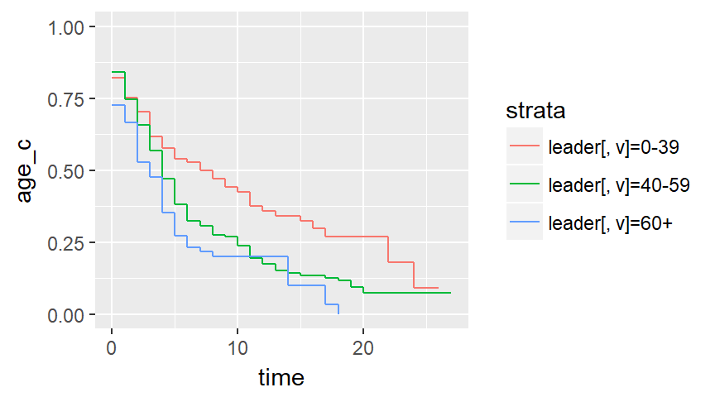
The leader data set, Kaplan-Meier curves

Slide 50
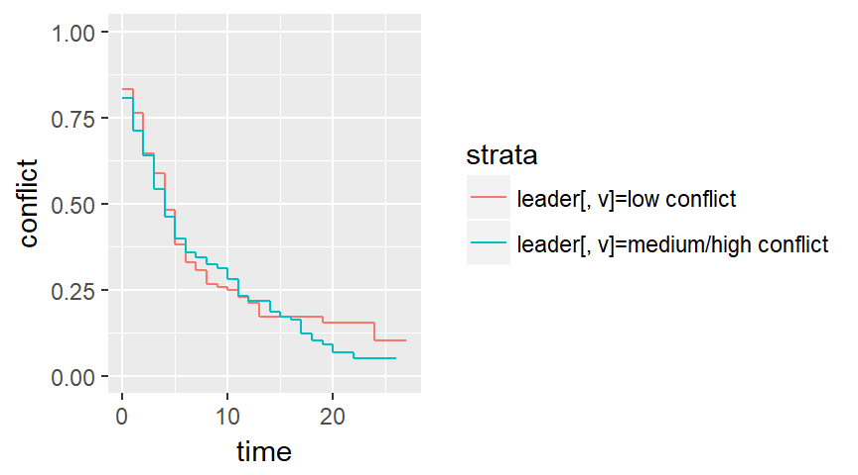
The leader data set, Kaplan-Meier curves

Slide 51
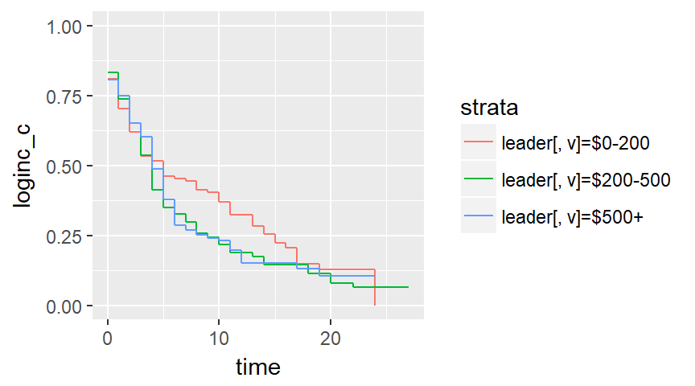
The leader data set, Kaplan-Meier curves

Slide 52
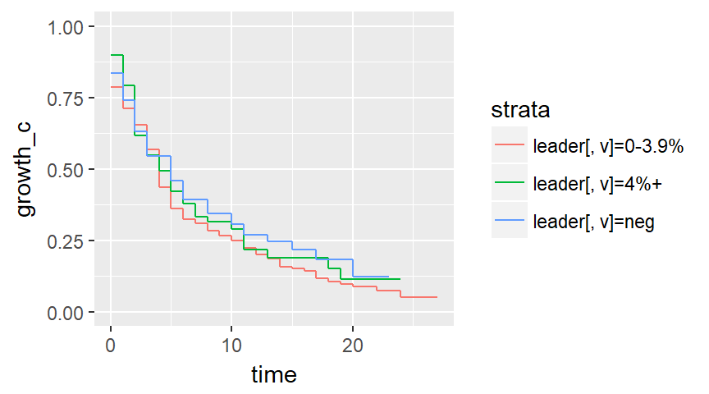
The leader data set, Kaplan-Meier curves

Slide 53
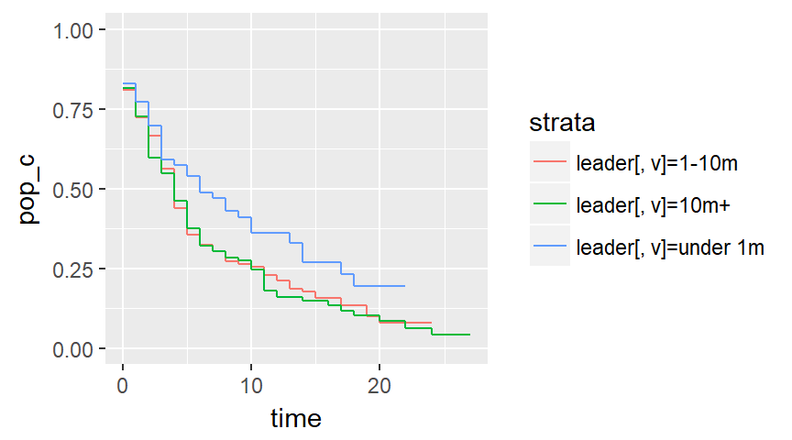
The leader data set, Kaplan-Meier curves

Slide 54
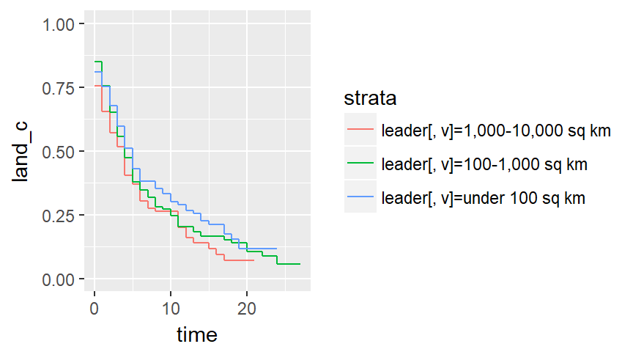
The leader data set, Kaplan-Meier curves

Slide 55
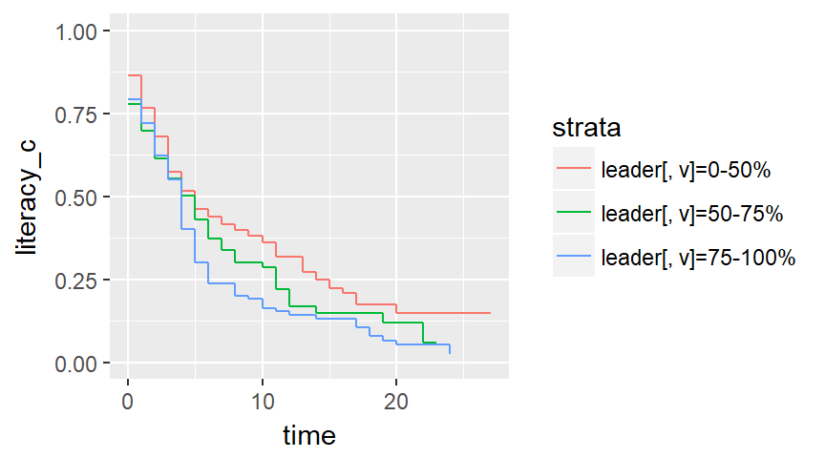
The leader data set, Kaplan-Meier curves

Slide 56
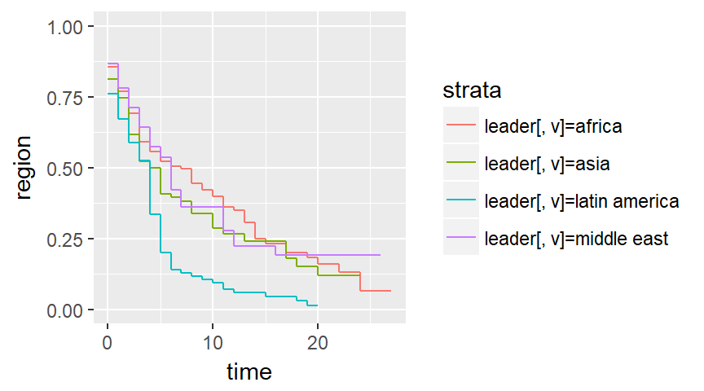
The leader data set, Kaplan-Meier curves

Slide 57
The leader data set
Run univariate Cox models
coef exp(coef) se(coef) z p
manner 0.138 1.148 0.116 1.19 0.23
coef exp(coef) se(coef) z p
military -0.00827 0.99176 0.11949 -0.07 0.94
coef exp(coef) se(coef) z p
age 0.02170 1.02194 0.00482 4.51 6.6e-06

Slide 58
The leader data set
Run a multivariate Cox model
coef exp(coef) se(coef) z p-v
manner 0.359963 1.433277 0.153237 2.349 0.0188
military -0.128457 0.879451 0.157289 -0.817 0.4141
age 0.024148 1.024442 0.004967 4.862 0.0001

Slide 59
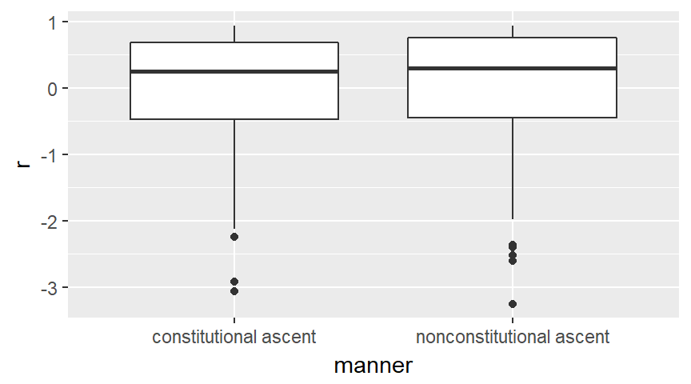
The leader data set, Martingale residuals

Slide 60
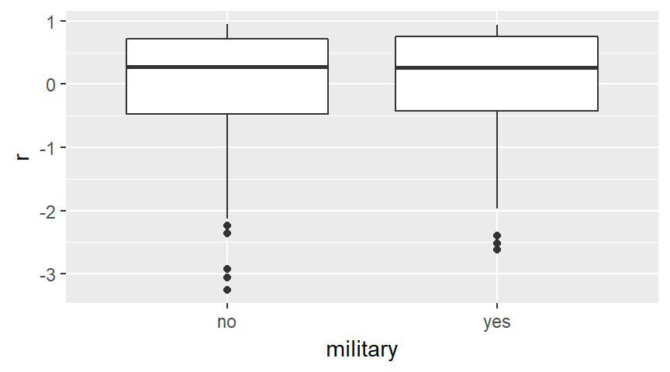
The leader data set, Martingale residuals

Slide 61
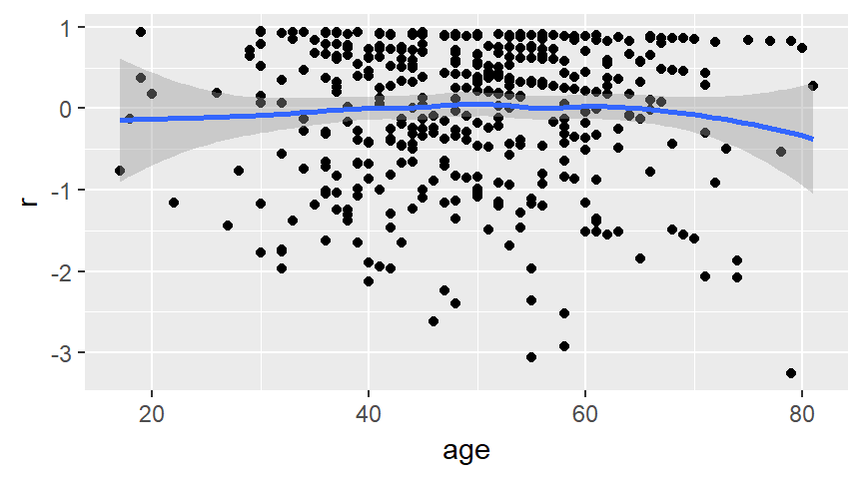
The leader data set, Martingale residuals

Slide 62
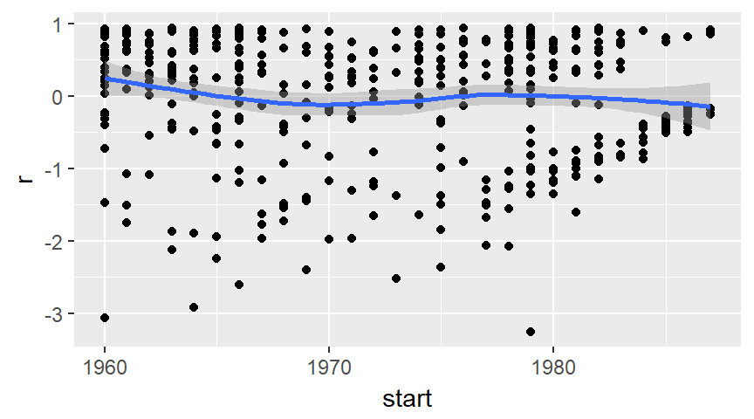
The leader data set, Martingale residuals

Slide 63
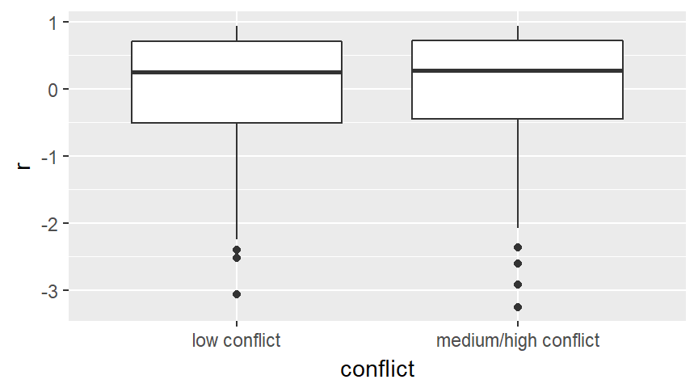
The leader data set, Martingale residuals

Slide 64
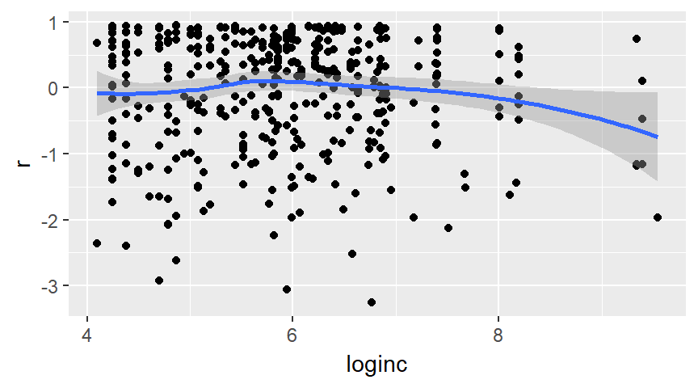
The leader data set, Martingale residuals

Slide 65
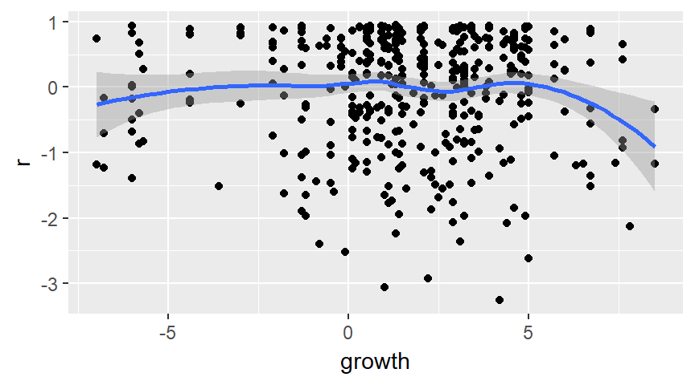
The leader data set, Martingale residuals

Slide 66
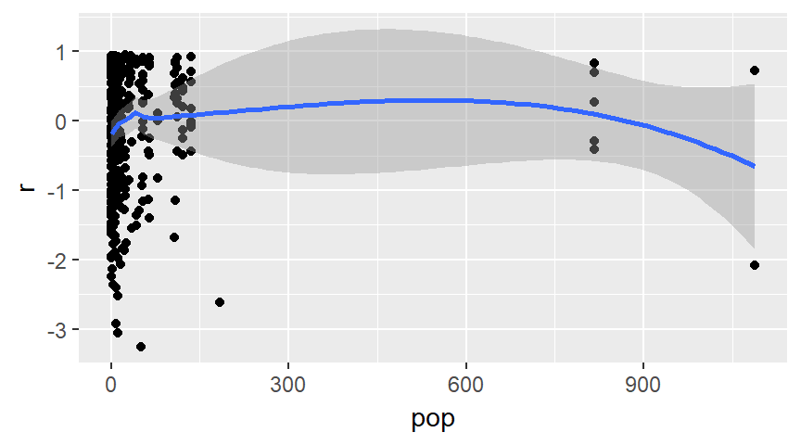
The leader data set, Martingale residuals

Slide 67
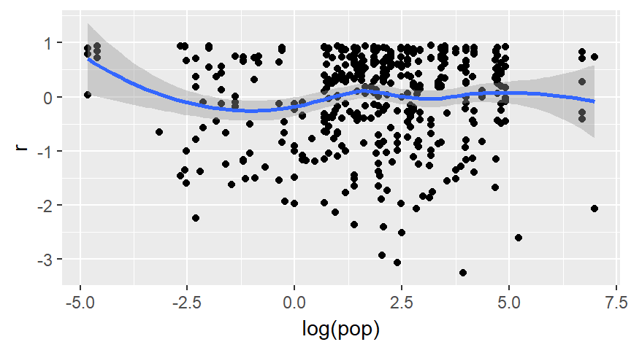
The leader data set, Martingale residuals

Slide 68
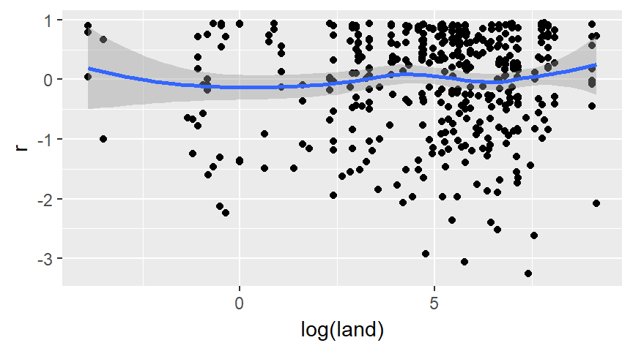
The leader data set, Martingale residuals

Slide 69
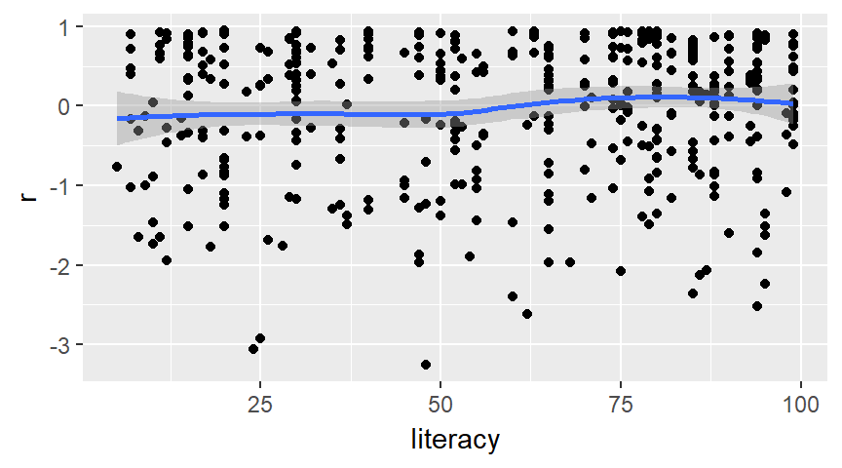
The leader data set, Martingale residuals

Slide 70
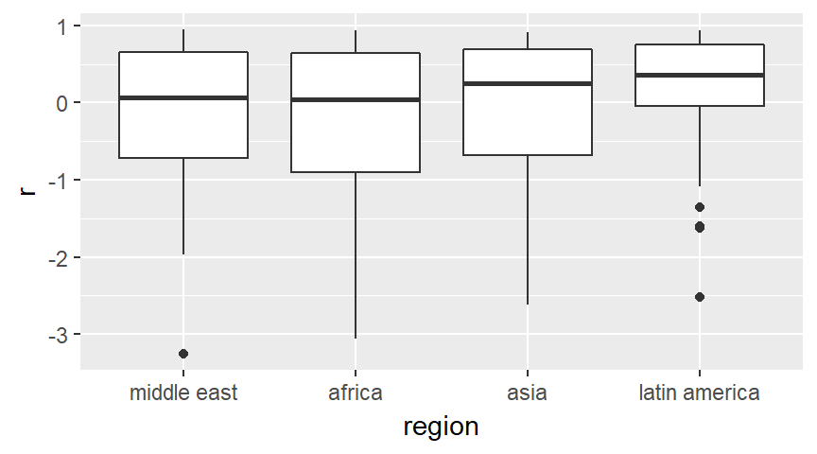
The leader data set, Martingale residuals

Slide 71
The leader data set
Revise your multivariate Cox model
coef exp(coef) se(coef) z Pr(>|z|)
manner 0.34961 1.41851 0.15279 2.288 0.02213
military -0.20673 0.81324 0.15670 -1.319 0.18706
age 0.02230 1.02255 0.00514 4.339 1.43e-05
loginc -0.18795 0.82866 0.07040 -2.670 0.00759
i_africa -0.37780 0.68537 0.21571 -1.751 0.07986
i_asia -0.21214 0.80885 0.22368 -0.948 0.34292
i_lat_am 0.51930 1.68085 0.18143 2.862 0.00421

Slide 72
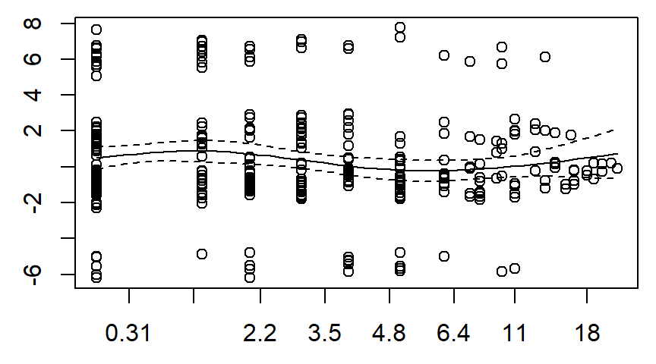
The leader data set, Schoenfeld residuals

Slide 73
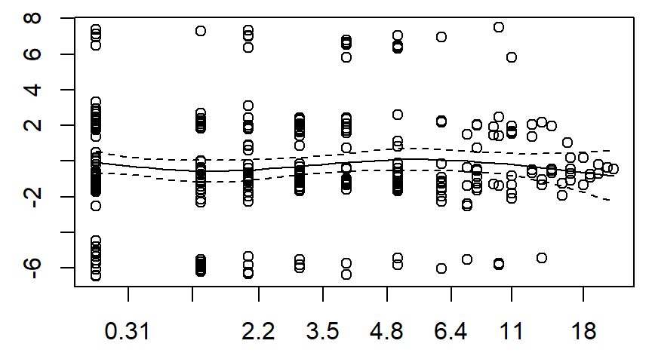
The leader data set, Schoenfeld residuals

Slide 74
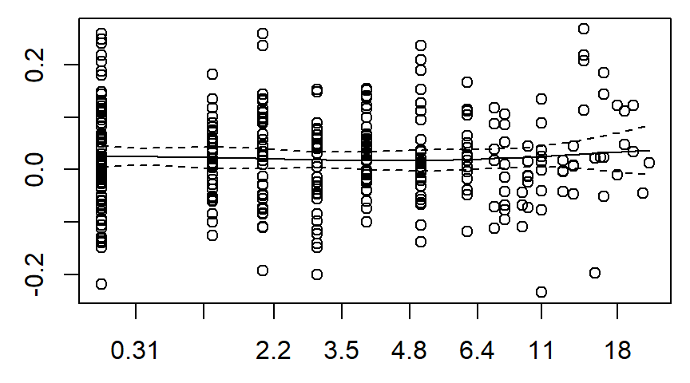
The leader data set, Schoenfeld residuals

Slide 75
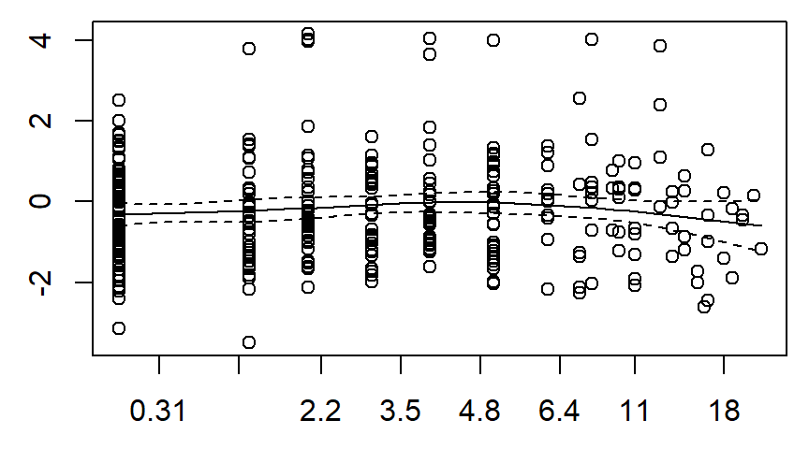
The leader data set, Schoenfeld residuals

Slide 76
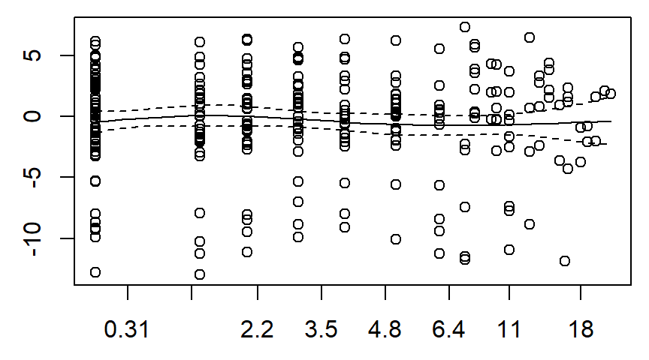
The leader data set, Schoenfeld residuals

Slide 77
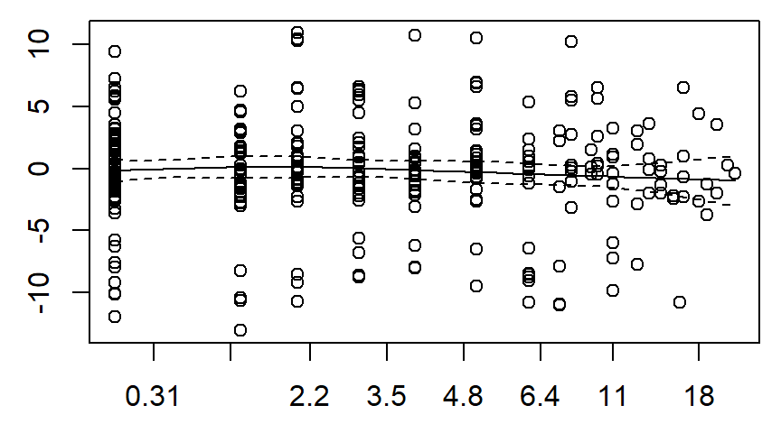
The leader data set, Schoenfeld residuals

Slide 78
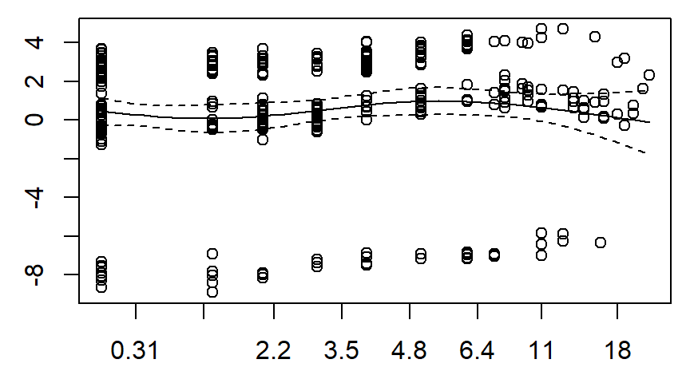
The leader data set, Schoenfeld residuals

Slide 79
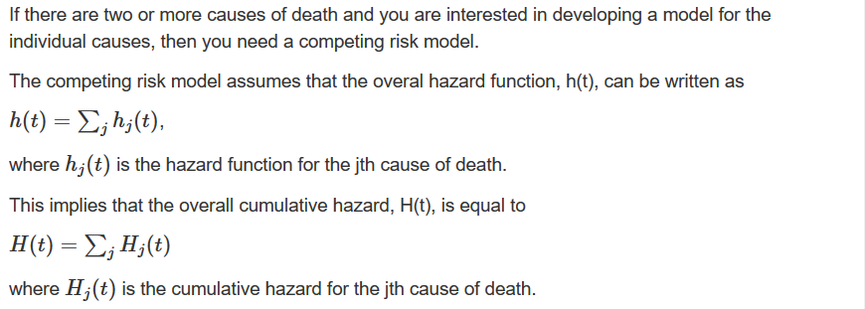
The competing risks model

Slide 80
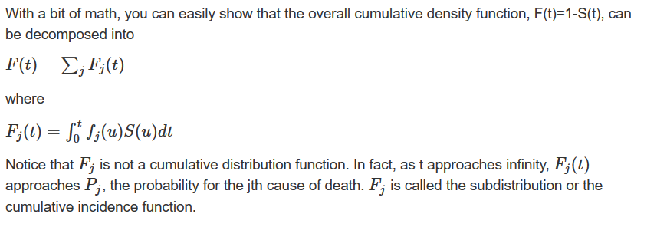
The competing risks model

Slide 81
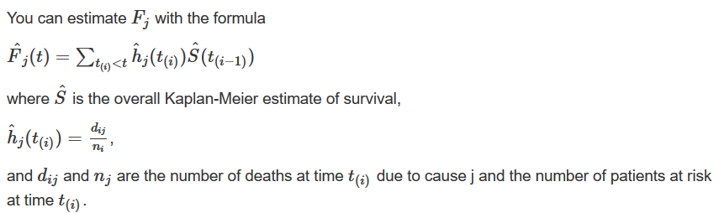
The competing risks model

Slide 82
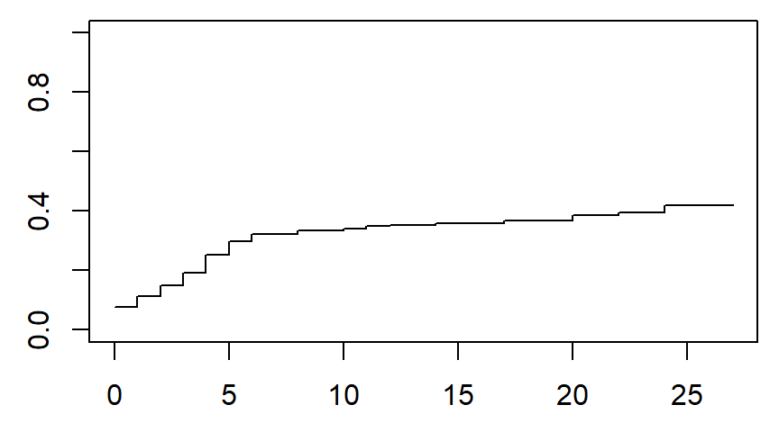
Competing risks, constitutional exit

Slide 83
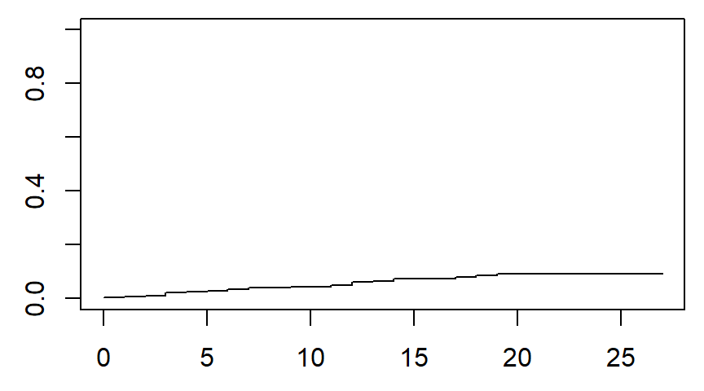
Competing risks, natural death

Slide 84
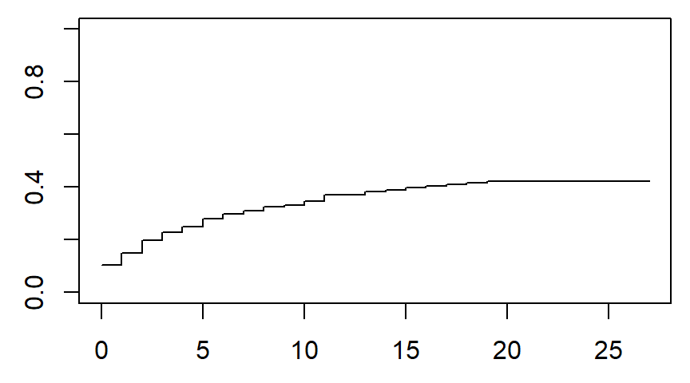
Competing risks, nonconstitutional exit

Slide 85

Competing risks, probability of no exit

Slide 86

Probability of no exit matches overall survival

Slide 87

The leader data set, competing risks

Slide 88

The leader data set, competing risks

Slide 89

Subgroup nonconstitutional ascent

Slide 90
Conclusion
What have you learned today?
Steps in a typical survival model
Descriptive statistics
Counts
Simple Kaplan-Meier curves
Univariate Cox models
Multivariate Cox models
Martingale residuals
Schoenfeld residuals
Competing risk analysis

